Slide 1
Introduction to Simulation and Modeling
(Lecture 2)

Slide 2
Introduction to Simulation
Our aim is not to derive and employ models just for the description of a circumstance, but for the subsequent simulation based on these models
Simulation modelling and analysis is the process of creating and experimenting with a computerized mathematical model of a physical system.

Slide 3
Many different types of systems can be simulated
Material-handling simulations have included analysis of cranes, forklifts, and automatically guided vehicles.
Warehousing simulations have involved the manual or automated storage and retrieval of raw materials or finished goods
Hospital and medical clinic models can be simulated to determine the number of rooms, nurses, and physicians for a particular location.
Airport operations simulations have been performed on airport security checkpoints, check-in counters, and gate assignments.
Information technology models typically involve how many and what type of network or support resources to have available.

Slide 4
Purposes of Simulation
Gaining insight into the operation of a system
Developing operating or resource policies to improve system performance
      To improve
Testing new concepts and/or systems before implementation
    To know performance of new system before purchasing new system,
Gaining information without disturbing the actual system
    critical or sensitive
    E.g. security checkpoint at a commercial airport

Slide 5
Advantages to Simulation
Experimentation in Compressed Time
      because some processes may take months or even years to complete
Reduced Analytic Requirements
    Study systems dynamically in real time during simulation runs
Easily Demonstrated Models
    Most simulation-specific software packages possess the capability of dynamically animating the model operation.
    Animation is useful both for debugging the model and also for demonstrating how the model works.
    Animation-based debugging allows the practitioner to observe flaws in the model logic easily.

Slide 6
Disadvantages to Simulation
Simulation cannot give accurate results when the input data are inaccurate.
Simulation cannot provide easy answers to complex problems.
Simulation cannot solve problems by itself.
    Potential solutions are developed but are never or only poorly implemented because of organizational inertia or political considerations

Slide 7
Basic Simulation Model Components
Three types of major components:
Entities
Queues
Resources

Slide 8
Basic Simulation Model Components
(1. Entities)
Entities:
Something that changes the state of the system
Entities do not necessarily have to be people; they can also be objects
Entity Batches:
The number of entities that arrive in the system at the same given time is known as the batch size.
Examples of batch arrivals are families going to a movie theatre.
The batch sizes may be two, three, four, or more.

Slide 9
Basic Simulation Model Components
Entity Inte-rarrival Times
The amount of time between batch arrivals is known as the inter-arrival time
Entity Attributes
These are variables that have values unique to each entity in the system.
Even though the entity attribute will have the same name, there could be as many different values as there are entities.
An example of an attribute of this type involves the entity’s arrival time. Each entity’s attribute ARRTIME would store the simulation system time that the entity arrived in the system

Slide 10
2. Queues
Entities generally wait in a queue until it is their turn to be processed
Simple systems generally use first-in-first-out (FIFO) queue priorities

Slide 11
3. Resources
Resources process or serve the entities that are in the queue.
Examples of resources are:
    Customer service representatives
    Barbers
    Loan officers
    ATMs

Slide 12
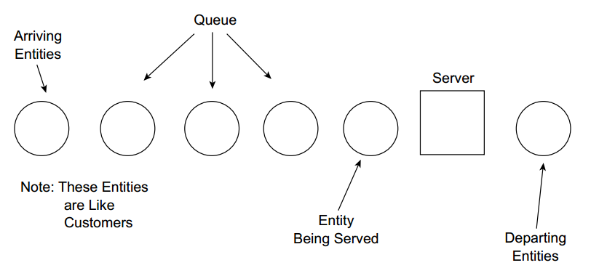
Basic Simulation Model Components

Slide 13
The Simulation Event List
The simulation event list is a means of keeping track of the different things that occur during a simulation run (Law and Kelton, 2000).
Anything that occurs during the simulation run that can affect the state of the system is defined as an event.
      Entity arrivals to the queue,
      Beginning of service times for entities,
      Ending of service times for entities.
These events change the state of the system because they can increase or decrease the number of entities in the system or queue or change the state of the resources between idle and busy

Slide 14
Measures of Performance Statistics
We are almost always interested in how well the actual system and hence the system model performs.
In order to ascertain this we will need to calculate some sort of output measure to eventually compare with other alternative forms of the model.
There are four commonly utilized measures of performance (Kelton et al., 2002):
    System time
    Queue time
    Time average number in queue
    Utilization

Slide 15
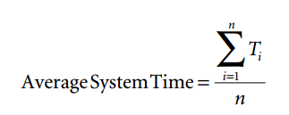
System time
It is the total amount of time that the entity spends in the system.
System time begins: entity arrives in the system and enters the queue.
System time ends : entity’s service time is complete and it exits the system
where Ti = the system time for an individual entity (arrival time – departure time) and n= the number of entities that are processed through the system.

Slide 16
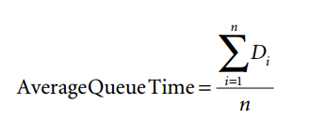
Queue Time
Time that an entity spends in the queue
Waiting time in the queue
where Di = the queue time for an individual entity (queue arrival time – service begin time) and N = the number of entities that are processed through the queue.

Slide 17
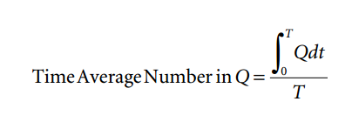
Time-Average Number in Queue
The time-average number in queue is a time-dependent statistic
It is the average number of entities that you could expect to see in the queue at any given time during the period of interest
Q = the number in the queue for a given length of time.
dt = the length of time that Q is observed.
T = the total length of time for the simulation.

Slide 18
Time-Average Number in Queue
Manual calculations of the time-average number in queue are best handled by drawing a two-axis graph of the system.
The vertical axis records the number of entities in the queue.
The horizontal axis records the simulation time.
A line is drawn at the number of entities in the queue for the length of time that number of entities is in the queue.

Slide 19
Time-Average Number in Queue
The entity time is calculated by calculating the area of each box.
Area of each Box : Number of entities (N) waiting multiplied by the ending time (Eet) for that number of entities in the queue minus the starting time (Est)for that number of entities in the queue.
Area =( N *(Eet - Est))
The total area is calculated by summing all of the individual areas.
The time average number in queue is then calculated by dividing the total area by the length of the simulation run.

Slide 20
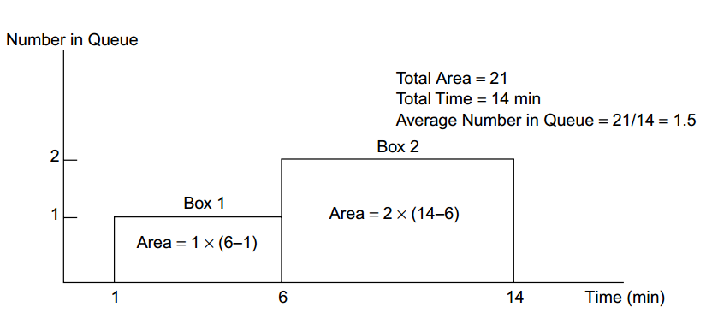
Time-Average Number in Queue

Slide 21
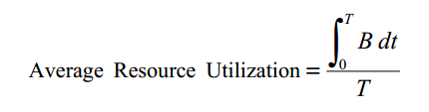
Resource Utilization
Resource utilization is also a time-dependent statistic.
At any given time a single resource can be either idle or busy.
The idle state corresponds to a resource utilization level of 0 and busy state corresponds to a resource utilization level of 1.
The formula for average resource utilization is
B = either 0 for idle or 1 for busy.
dt= the length of time that B is observed.
T= the total length of time for the simulation.

Slide 22
Resource Utilization
As with the time-average number in queue, we are summing the length of time that the resource is either busy or idle and then dividing by the total time of the simulation run.
The average utilization rate can be calculated using a bar chart in the same manner as for the time-average number in queue.
The only difference is that the vertical axis of the graph can take only a value of either 0 or 1.

Slide 23
Summary
Any Questions?

